Slide 1

Presented by : - AMRUTA KUMBHAR [17CS024] NEERAJ PATIL [17CS036] SHIVANI PATIL [17CS037] DEEPAK PITAMBARE [17CS040]
AISSMS college of engineering Pune
Department of Computer engineering
Project Name: CAFEBOOKING

Slide 2
Content
Introduction
Proposed System
System Requirement specification
Required diagram
Snapshots
Conclusion
References

Slide 3
INTRODUCTION
Project Description:
This project Cafe Booking is an online application in which user can register themselves. Cafe Booking system provides online help to the users for book the cafe with other useful option.
In Project application any type of user can register and either pay to the admin after registration or it can book only. After that user can available for provide services. Earlier service was done manually and it was all at a time consuming work. Now it is all possible in a fraction of second. It is all done online without much time consuming. This application is designed to do a whole lot more than just reduce time.
By using this application you don’t need to go anywhere and wait for it. You can book and give any type of order.

Slide 4
There are Two users in the system:-
1. Customer
2. Cafe Administrator
Brief description on the modules:
Customer: A customer can register himself. After registration, he will get user id and password and then he will be directed to his homepage through login. Here he will get details about the café like menu, table booking in advance , café location, online payment .
Cafe Administrator: Administrator has the full authority over the application. He can view all the registered customer. He can edit the pages and update them. He can view all the application details also.

Slide 5
Hardware and Software Specification:
The development of this project deals with the following environment:-
Hardware requirements
Software requirements
Hardware Requirements:
The selection of hardware is very important in the existence and proper working of any software. In the selection of hardware, the size and the capacity requirements are also important.
RAM Capacity -------- 8GB
Hard Disk -------- 1TB
Processor -------- Intel i5 processor

Slide 6
2. Software Requirements:
One of the most difficult tasks is that, the selection of the software, once system requirement is known is determining whether a particular software package fits the requirements.
After initial selection further security is needed to determine the desirability of particular software compared with other candidates.
Operating System -------- Windows 10
Browser -------- Chrome
Database Server -------- firebase
Database Connectivity -------- JDBC
5.Other Tools & Technologies -------- Android studio, JDK(Version 1.7)

Slide 7
User Interfaces :-
The interface must be easy to understand. The user interface includes
Data format: The data entered by the users will be alpha numeric.
Hardware Interfaces:-
Hardware recommended by all the software needed.
Software Interfaces:-
Compatible operating system: Windows 10

Slide 8

SYSTEM ARCHITECTURE
UIMODEL
VIEW MODEL
INTERACT0R
DOMAINMODEL
REPOSITORY
DATASOURCES
DATABASE

Slide 9
Snapshots

Slide 10
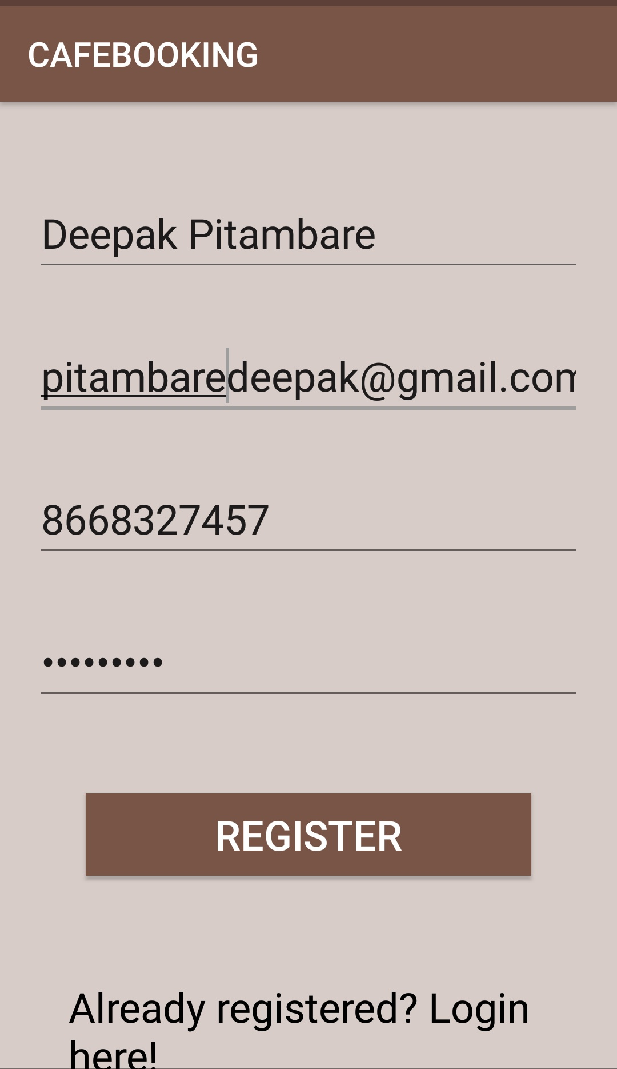
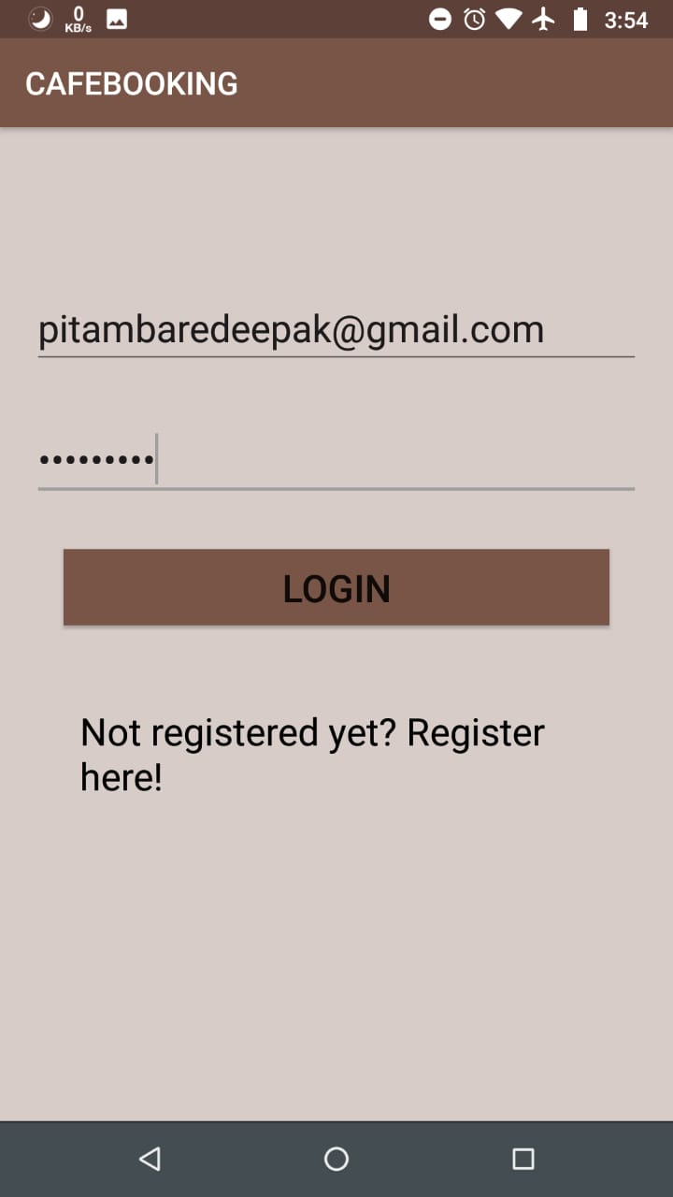
Registration And Login

Slide 11
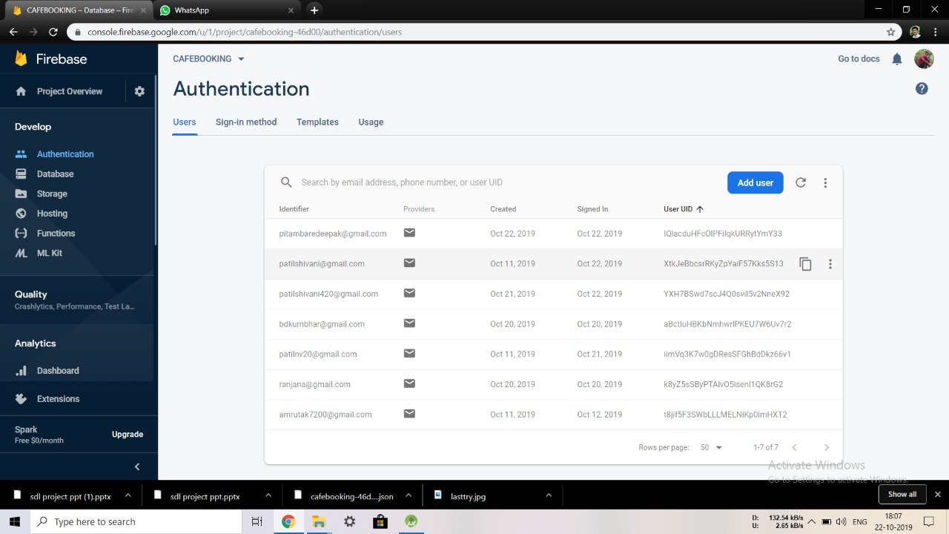
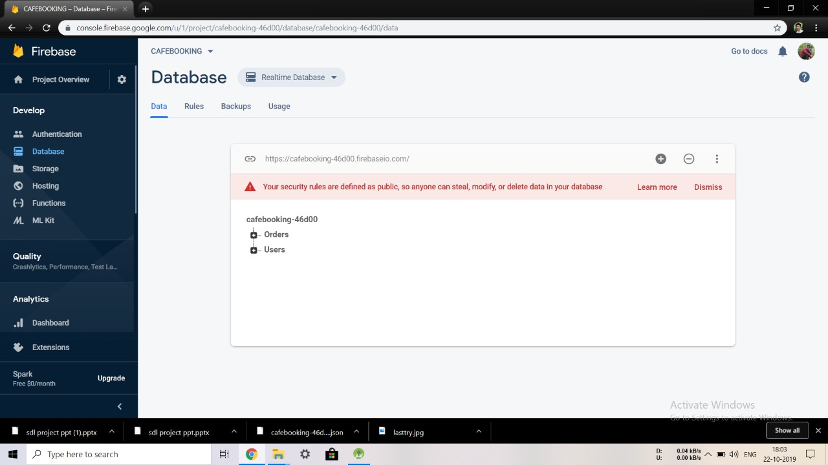
Database

Slide 12
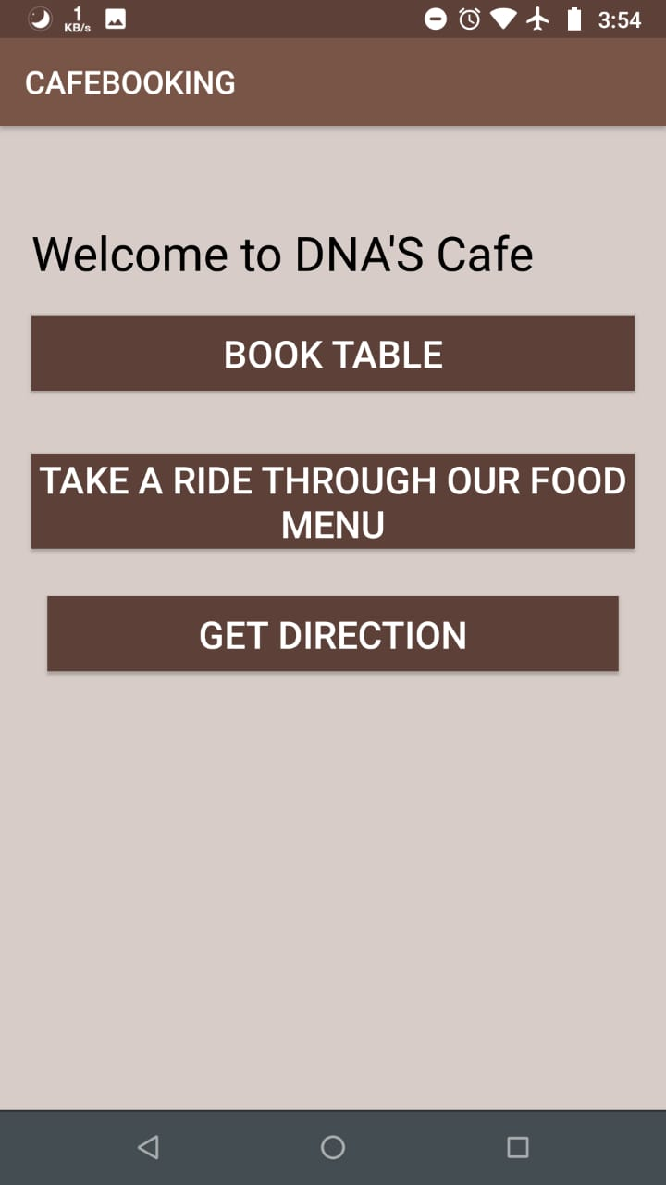
Welcome

Slide 13
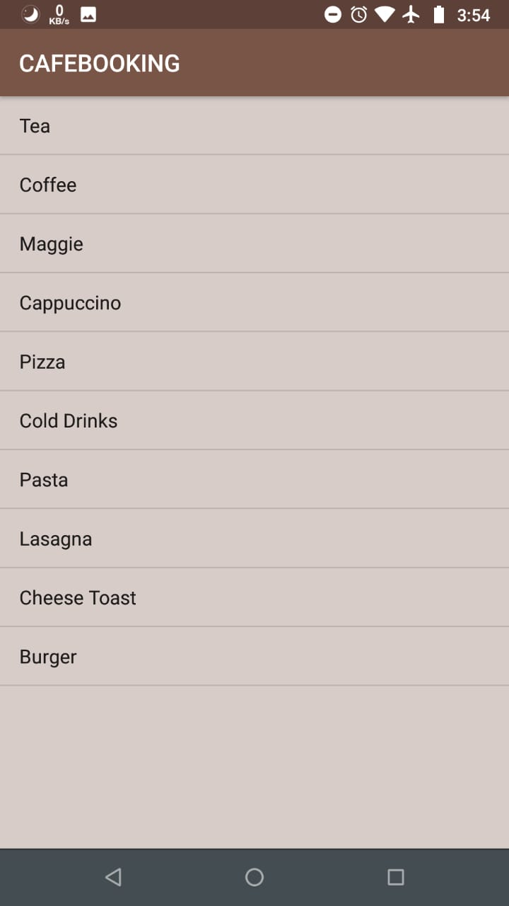
Menu List

Slide 14
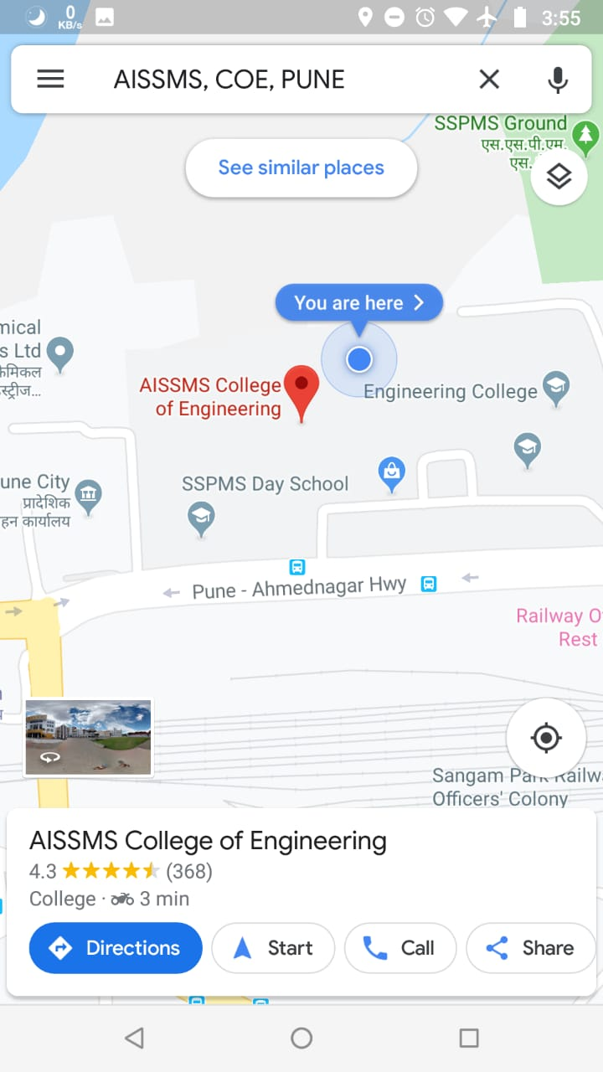
Get Direction : Map

Slide 15
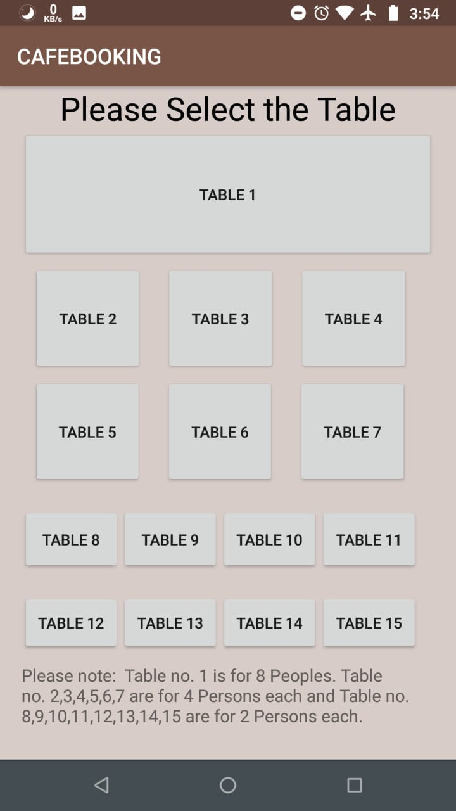
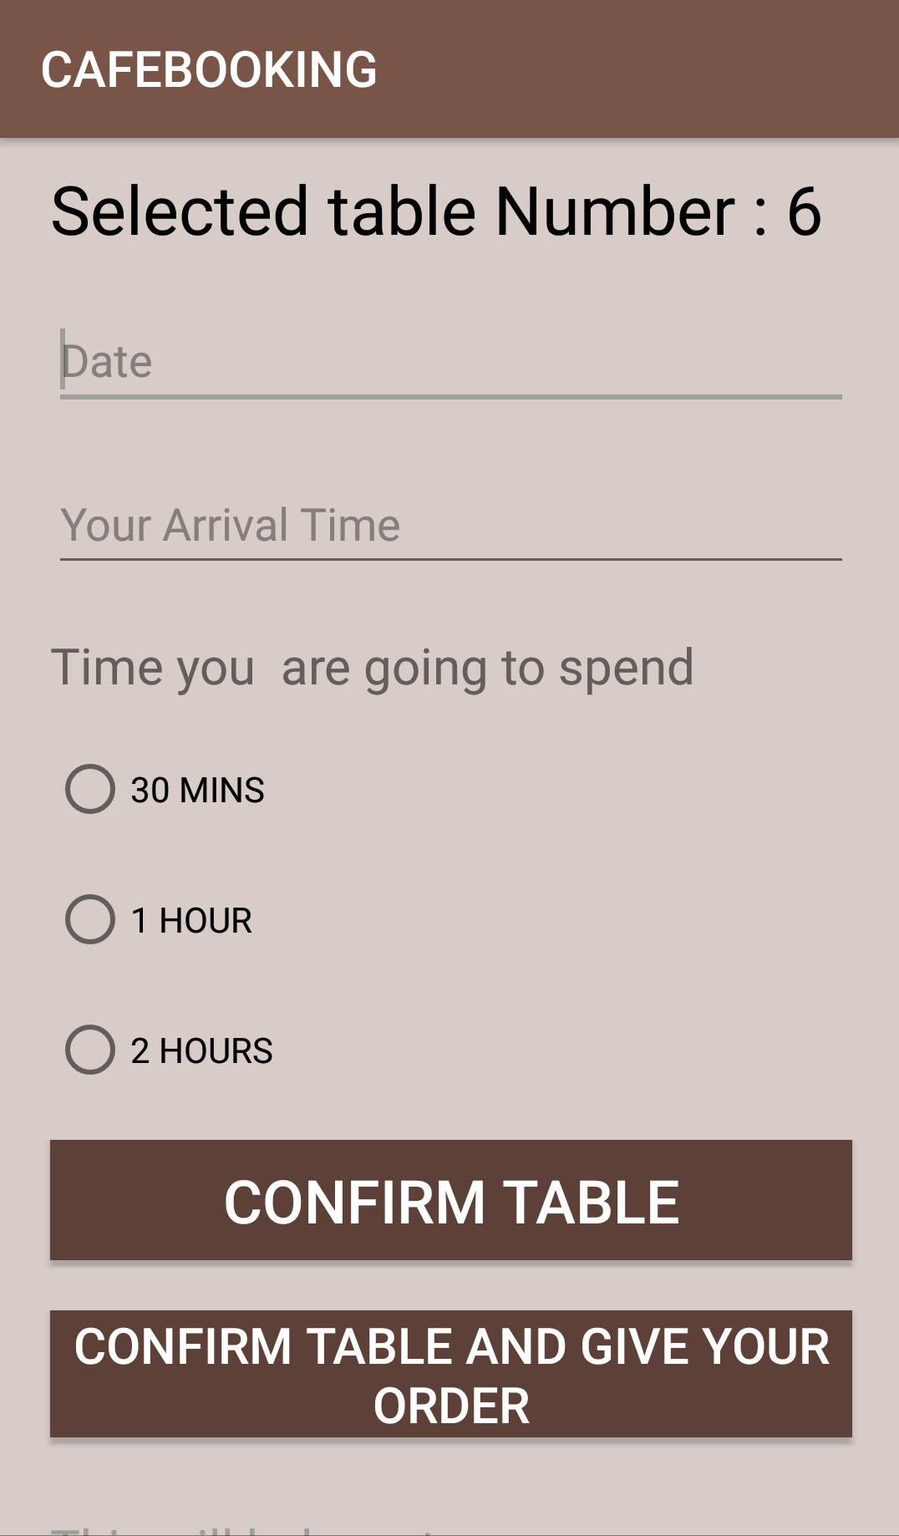
Table Details And Booking

Slide 16
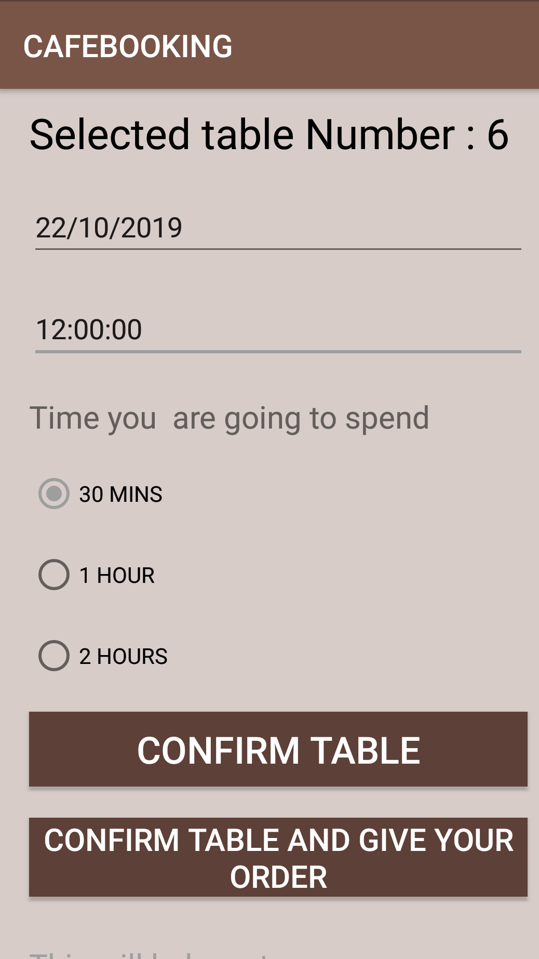
Advance Booking

Slide 17
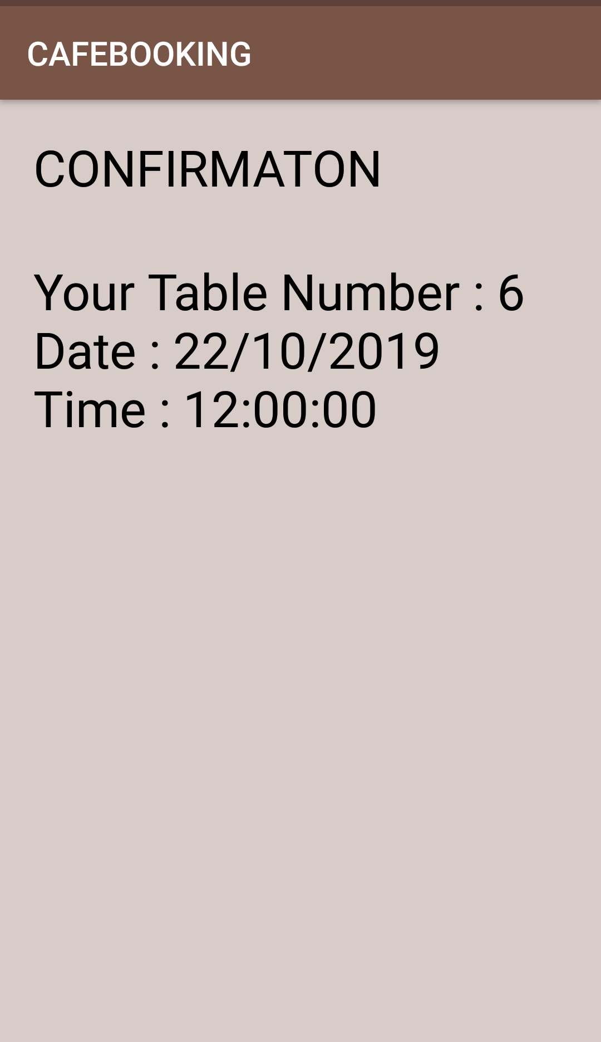
Table Details And Confirmation

Slide 18
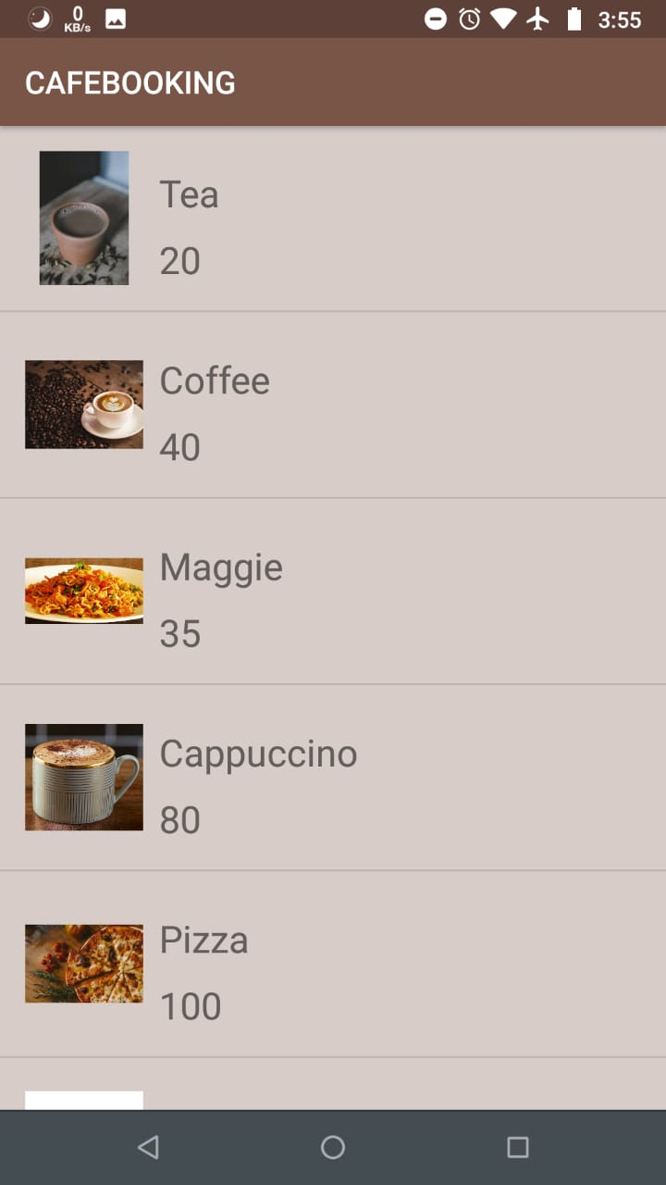
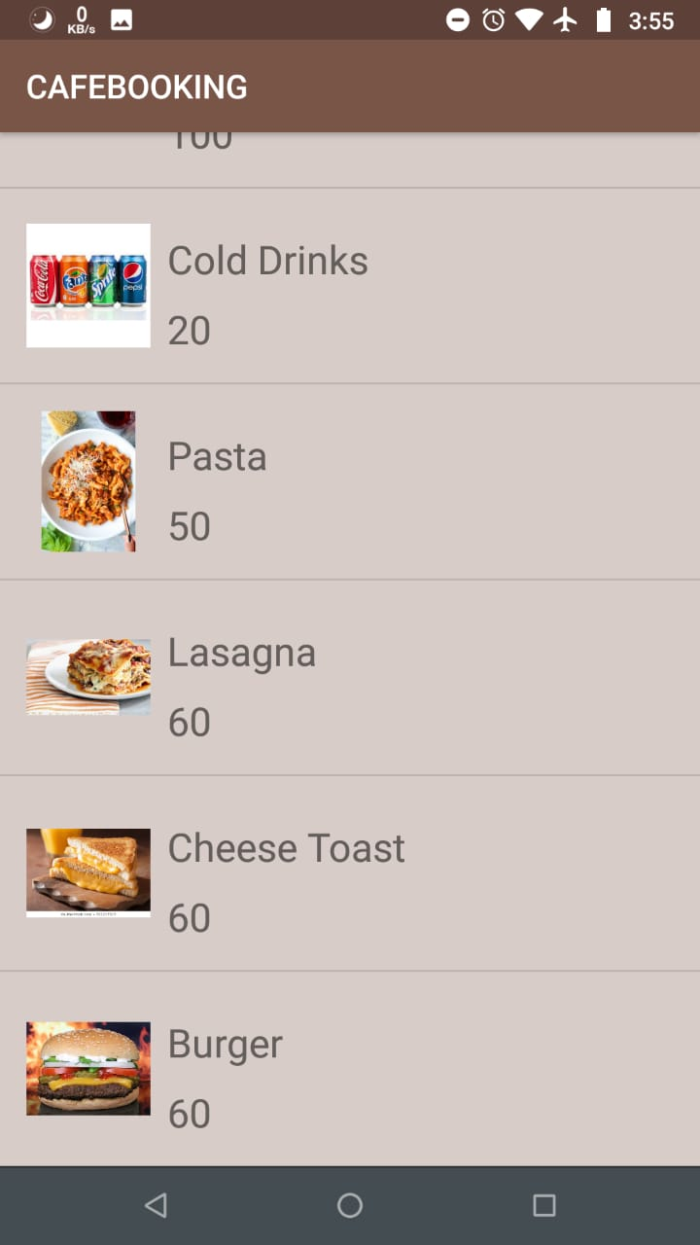
Confirm Order

Slide 19
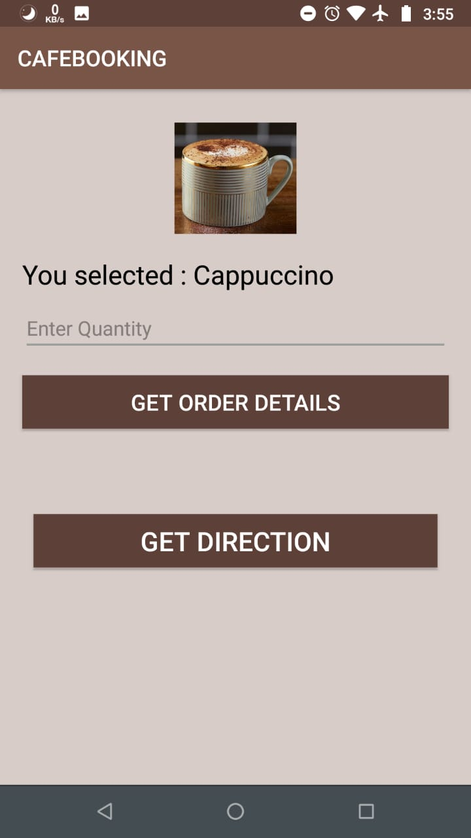
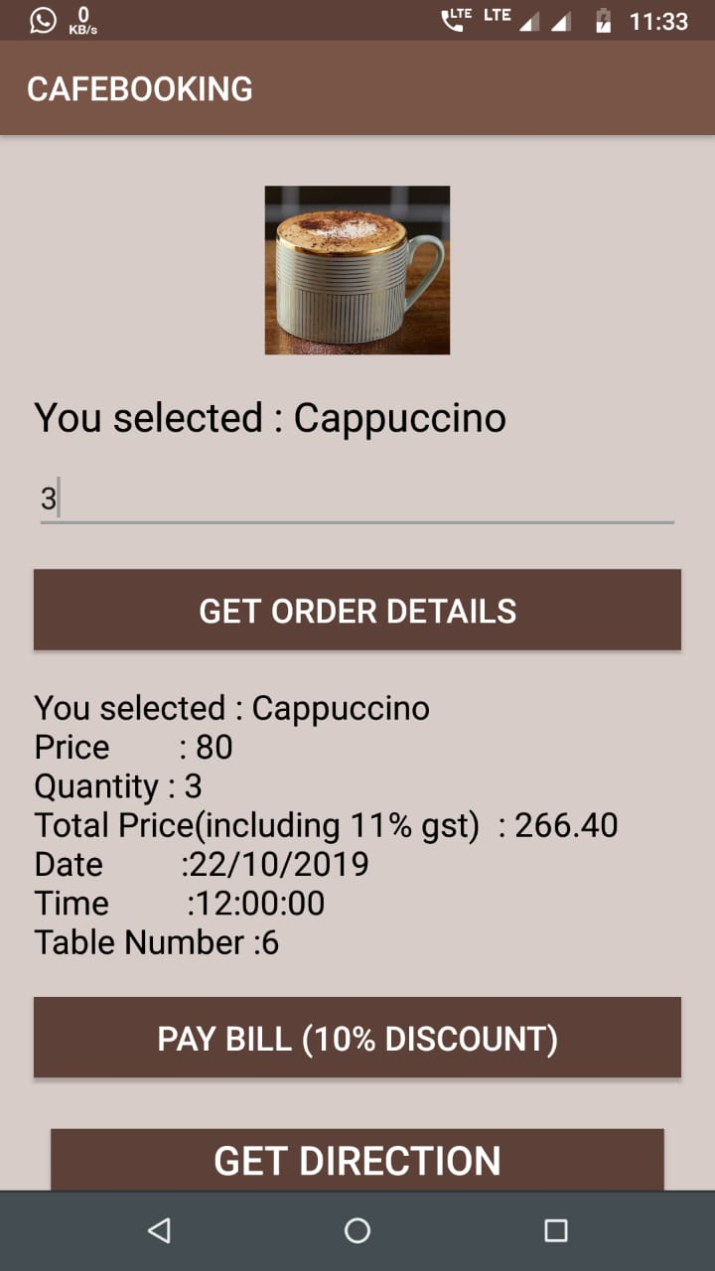
Order Details

Slide 20
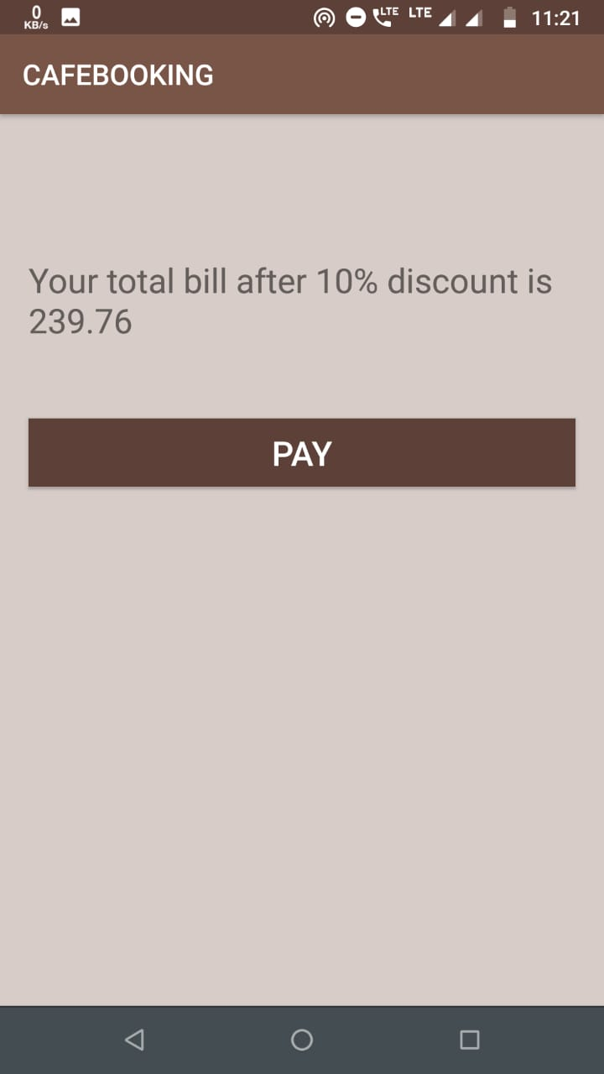
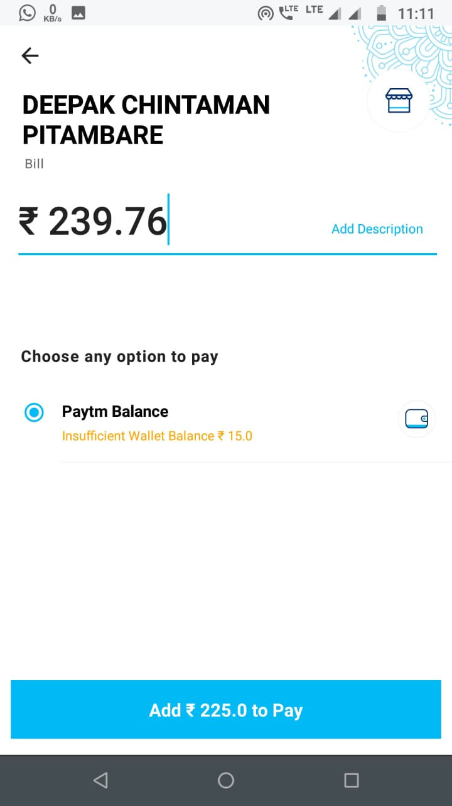
Discounted Bill

Slide 21
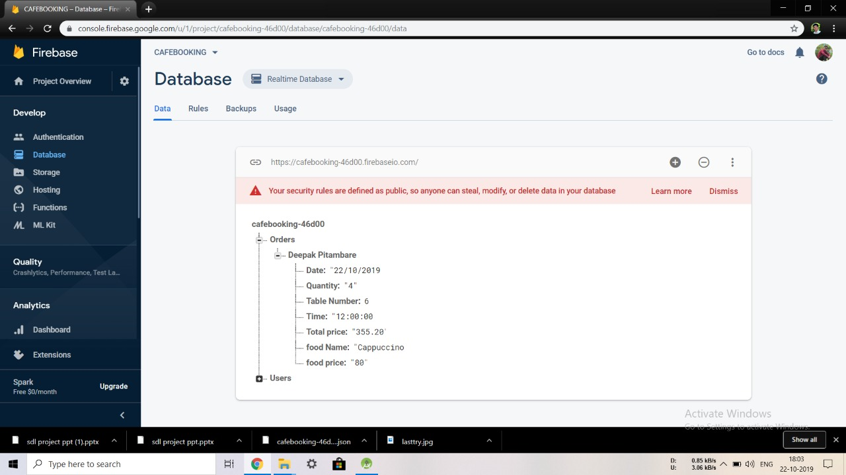
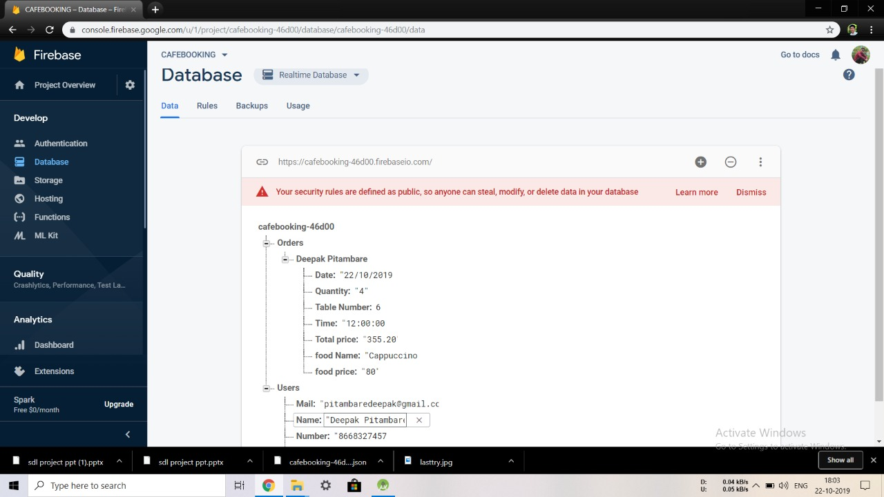
Database : Order Details

Slide 22
Conclusion:
Hence we have implemented the CAFÉBOOKING successfully incorporate all the requirements. Appropriate care has taken during database design maintain database integrity and to avoid redundancy of data.
The quality fusers like correctness, efficiency, usability, maintainability, portability, accuracy, errors, tolerance, expandability and communicatively all are successfully done.
Future Enhancement:
We can add more cafés that provides different options to the customer.
We can add online payment option for bill payments.
Special offers will be added by the café and the message system will also be added that will inform the customer about offers and their order, booked table, time, etc.
If there is a case of shifting table or changing time accordingly the service will be made flexible by this android app.

Slide 23
References
Website:
www.google.com
www.developers.com
www.youtube.com
www.javatpoint.com
www.tutorialspoint.com

Slide 24
THANK YOU!

